Slide 1
A tutorial explaining by example Tryton installation & usage for first time administrators & users of the system - Administration
Tryton By Example
Github - https://github.com/clixwise/tryton-by-example Version of documentation : 01.01 Dated 28-Apr-21 Version of Tryton : 5.8 Verified for execution on : Windows 10 & Powershell 7 Documentation : GNU GPL Author : Marc Rottiers

Slide 2
Foreword
This tutorial aims to expedite the process of learning the basics of the TRYTON ERP. System administrators and end-users who want to explore this package should benefit. On the other hand, if you practise the system already, the present documentation will be of little added value.
The tutorial rests on a personal initiative. Its content does not contain nor replace official TRYTON documentation in any manner. In fact, this material can be discarded once one feels sufficiently familiar with the system. One should then taylor the usage of the system to the specific administrative workflows in the company. The material describes the installation procedure as well as some use cases by example. It leans on explicative documents as well as accompanying database samples and execution scripts. The author acknowledges documentation that he had the opportunity to analyse for the purpose of creating the present material. The tutorial is written for running TRYTON 5.8 on Windows 10 Home. There is no warranty that the same results will or can be achieved using a different setup. In particular, the author cannot take responsibility for loss or corruption of data that would result from handling processes based on information in the present documentation. He will be grateful to receive any comments in order to improve quality. Please post any feedback on https://github.com/clixwise/tryton-by-example

Slide 3
Known Issues
These are unresolved topics that relate to the present documentation, not to the system functioning.
Document | Subject
Tryton 5.8 - Doc 80.01 - Ancillaries | Attaching a document to an item causes an exception
Tryton 5.8 - Doc 15.05 - Sales | When a « Sale » evolves into « Processing », a « Customer Shipment » is produced. Contrarily to a « Customer Invoice », the property « Reference » is not editable. Incidentally, « Reference » in « Customer Invoice » and « Customer Shipment » is not set from « Customer Sale »
Tryton 5.8 - Doc 10.05 - Purchases Tryton 5.8 - Doc 15.05 - Sales | Account Move Lines are generated when « Invoice » into « Validated » state Account Move Lines are not generated when « Invoice » into « Validated » state Examine why
Tryton 5.8 - Doc 10.05 - Purchases | State transition to « Posted » possibly contains erroneous state information

Slide 4
Related files & documents

Slide 5
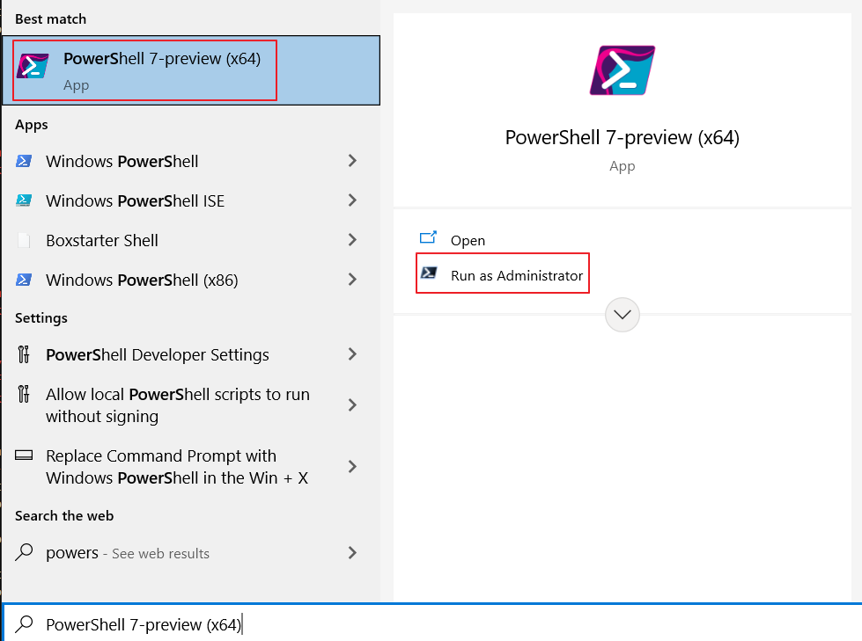
List of files related to some of the topics covered in this document
./"Tryton 5.8 - Doc 01.01 - Installation & administration.database.tryt20.backup" | Backup « tryt20 » database
./"Tryton 5.8 - Doc 01.01 - Installation & administration.database.tryt20.restore" | Restore « tryt20 » database
./"Tryton 5.8 - Doc 01.01 - Installation & administration.docker.tryt20.create" | Create « tryt20 » containers
./"Tryton 5.8 - Doc 01.01 - Installation & administration.docker.tryt20.delete" | Delete « tryt20 » containers
./"Tryton 5.8 - Doc 01.01 - Installation & administration.docker.tryt20.start" | Start « tryt20 » containers
./"Tryton 5.8 - Doc 01.01 - Installation & administration.docker.tryt20.stop" | Stop « tryt20 » containers
The « *.ps1 » files above are Powershell scripts
Powershell can be accessed as indicated
The above scripts need some tuning with respect to the exact operation to be performed

Slide 6
Table of Contents

Slide 7
TOC
Docker Installation
Container Installation
Tryton - « Permanent » Data
Tryton - « Volatile » Data
Postgres - « Permanent » Data
Docker Administration
Commands
Reboot
Shell Execution
Container Uninstallation
Database Backup
Tryton
Postgres
Database Restore
Tryton
Postgres Database Operations
Tryton
Postgres
User Interface
PgAdmin4
Tryton
References
Installing Docker on Windows
How to install containers
Installing Tryton with data residing on volume outside of container
Installing Tryton with data inside of container
Installing Postgres with data on volume
How to administer containers
Commands for managing containers
What when rebooting PC
Executing commands inside a container
How to uninstall containers
Database Backup
Backing up a Tryton database (UTF-8)
Backing up a Postgres database (UTF-8)
Database Restore
Restoring a Tryton database
Restoring a Postgres database
Operations about the respective databases
Tryton
Postgres User Interface
Setting up & Exploring the pgadmin4 interface
Logging / Logout - Usage
Some interesting documentation
In blue essential information relative to TRYTON
Consider other sections if unfamiliar with Docker or Postgres

Slide 8
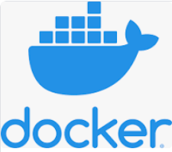
Docker Installation

Slide 9
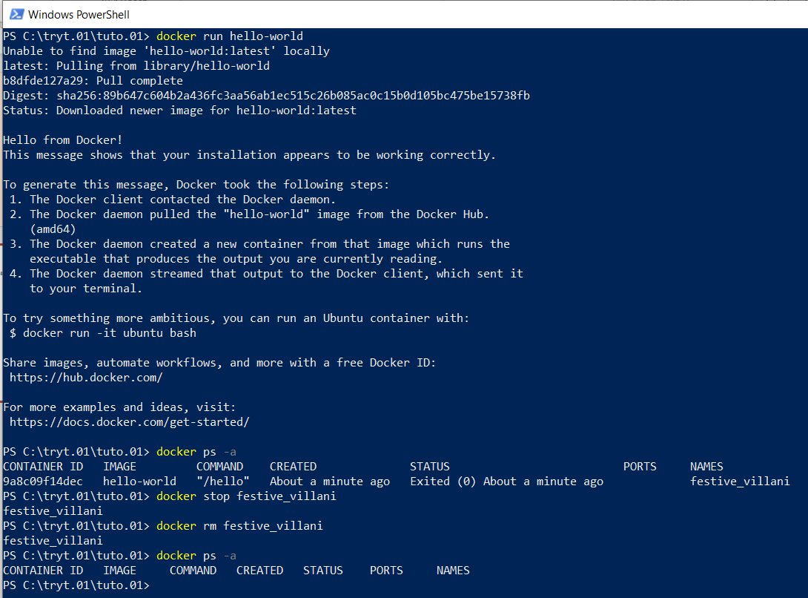
Installation
Context Windows 10 & Powershell 7
Remark
We do not use WSL2 Download See https://docs.docker.com/get-docker/ Control
Run « docker run hello-world »

Slide 10
Container Installation

Slide 11
Motivation
We install two series of Docker containers :
Series 1 is about the TRYTON ERP system : its server application, its database and file systems
Series 2 is about managing POSTGRES databases and interfacing them using « pgAdmin4 »
Series 1 is compulsory since it is about the TYTON ERP system : server & database
Series 2 is optional as its purpose is to use « pgAdmin4 » for direct access to Postgres databases

Slide 12
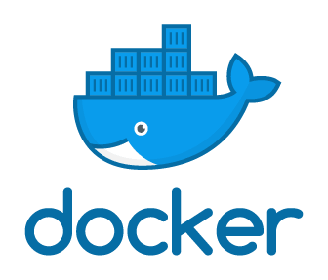

Motivation
PGADMIN4 User Interface
Browser
TRYTON User Interface
- TRYTON will be accessed by default using « localhost:8000 » for « TRYTON »
- POSTGRES will be accessed by default using « localhost:80 » for « pgAdmin4 »
Application Server
Application Server
Tryton Containers
Postgres & pgadmin4 Containers
Database Server
Database Server
Tryton
Postgres
Optional
Postgres
TRYTON Docker Structure
POSTGRES Docker Structure (optional)

Slide 13
Docker and Databases
Installing TRYTON ERP Containers TRYTON Docker can be installed in one of two ways with respect to its database and files container :
- In a permanent fashion. It means that the database and any « attachment » files will remain available when a Docker container is removed, accidentally or not.
- In a semi-permanent fashion. It means that if we delete the Docker container the TRYTON database will disappear together witn any « attachment » files storing information alongside the database.
Installing POSTGRES Containers (Optional)
The same remark applies.
Convention about password names
Everywhere a password is needed we give it the value « Password »

Slide 14
Commands
Most commands have been explored during the installation process. We repeat them here for convenience
Container commands
docker run hello-world | Check installation still operational
docker ps -a | List containers
docker stop a_container_name | Stop a container
docker start a_container_name | Start a container
docker rm a_container_name | Remove a stopped container
docker logs a_container_name | Logs
docker system prune | Remove stopped containers, unused networks and volumes

Slide 15
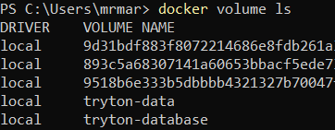
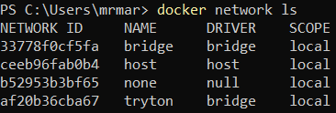
Commands
Volume commands
docker volume create a_volume_name | Create a volume
docker volume ls | List the volumes
docker volume rm a_volume_name | Remove a volume
docker volume prune | Remove all unused volumes. « Unused » = not container referenced
docker volume inspect a_volume_name | Inspect a volume
Volume commands
docker network create a_network_name | Create a network
docker network ls | List the networks
docker network rm a_network_name | Remove a network
docker network prune | Remove all unused networks. « Unused » = not container referenced
docker network inspect a_network_name | Inspect a network

Slide 16
Commands
Bash Shell commands
docker container exec -it a_container_name /bin/bash | Attach container Bash shell to the terminal
docker container exec -it tryt20-postgres /bin/bash | Example for above
/usr/bin/pg_isready --dbname=tryt20 | /var/run/postgresql:5432 - accepting connections
Ancillary commands
docker exec tryt20-postgres sed -n 4p /var/lib/postgresql/data/pgdata/postmaster.pid | Display postgres port

Slide 17
Tryton - « Permanent » Data

Slide 18
Motivation
The next slides demonstrate a way of setting up the Tryton environment whereby the database and the files are preserved when the corresponding TRYTON container is « removed ». This solution is inspired from [https://discuss.tryton.org/t/how-to-run-tryton-using-docker/3200]. This method performs an additional « volume creation » to store (binary) data outside the database.
Also refer to :
https://stackoverflow.com/questions/18496940/how-to-deal-with-persistent-storage-e-g-databases-in-docker
https://docs.docker.com/storage/volumes/

Slide 19
Execute
Install :
A container « tryt01-postgres » from docker image « postgres » ; « -p 5434: » can be changed (default : 5432)
A container « tryt01 » from docker image « tryton/tryton » ; « -p 8001: » can be changed (default : 8000)
Two volumes : « tryt01-database » & « tryt01-datafile »
One network : « tryt01-network »
A nameless container is used to initialize the TRYTON database.
The location where the volumes for the TRYTON database and the TRYTON files (binary attachments) are stored :
Subfolder « tryt01-database » with respect to the directory (Get-Location) where the Powershell script executes
Subfolder « tryt01-datafile » with respect to the directory (Get-Location) where the Powershell script executes
Server « tryt01 »
TRYTON Docker Structure
Tryton Containers
Database « tryt01-database »
TRYTON File Structure
Tryton Folders
« tryt01-database »
« tryt01-datafile »
# Some useful commands in case of retry docker stop a_container_name
docker rm a_container_name docker volume prune docker network prune dir env:
TRYTON

Slide 20
Execute - « tryton »
In this script, we use « tryton », the standard name.
docker pull tryton/tryton
docker network create tryton-network
$POSTGRES_PASSWORD ="Password" # Tryton database container – Create $TRYTON_VOL_DB = (Get-Location).tostring().replace("\","/").replace("C:/","c//") + "/"+"tryton-database" docker volume create tryton-database
docker run --name tryton-postgres --env PGDATA=/var/lib/postgresql/data/pgdata --env POSTGRES_DB=tryton --env POSTGRES_PASSWORD=${POSTGRES_PASSWORD} --volume ${TRYTON_VOL_DB}:/var/lib/postgresql/data --network tryton-network -p 5432:5432 --detach postgres Start-Sleep -Seconds 20 # required to wait for postgres to properly connect docker exec -tiu postgres tryton-postgres psql -c '\l+' dir # Tryton transient container to initialize the tryton database in its container
docker run --env DB_HOSTNAME=tryton-postgres --env DB_PASSWORD=${POSTGRES_PASSWORD} --network tryton-network --interactive --tty --rm tryton/tryton trytond-admin -d tryton --all docker exec -tiu postgres tryton-postgres psql -c '\l+'
# Tryton server container $TRYTON_VOL_FI = (Get-Location).tostring().replace("\","/").replace("C:/","c//") + "/"+"tryton-datafile" docker volume create tryton-datafile
docker run --name tryton --env DB_HOSTNAME=tryton-postgres --env DB_PASSWORD=${POSTGRES_PASSWORD} --volume ${TRYTON_VOL_FI}:/var/lib/trytond/db --network tryton-network --publish 127.0.0.1:8000:8000 --detach tryton/tryton dir
# Obtain Gateway address for usage in pgadmin4 - creating server docker inspect tryton-postgres -f "{{json .NetworkSettings.Networks }}" # "Gateway":"172.18.0.1","IPAddress":"172.18.0.2"

Slide 21
Execute - « tryt01 »
In this script, we use « tryt01 » so that it is easy to create a separate « tryt02 » ensemble.
docker pull tryton/tryton
docker network create tryt01-network
$POSTGRES_PASSWORD ="Password" # Tryton database container – Create $TRYTON_VOL_DB = (Get-Location).tostring().replace("\","/").replace("C:/","c//") + "/"+"tryt01-database" docker volume create tryt01-database
docker run --name tryt01-postgres --env PGDATA=/var/lib/postgresql/data/pgdata --env POSTGRES_DB=tryt01 --env POSTGRES_PASSWORD=${POSTGRES_PASSWORD} --volume ${TRYTON_VOL_DB}:/var/lib/postgresql/data --network tryt01-network -p 5433:5432 --detach postgres Start-Sleep -Seconds 20 # required to wait for postgres to properly connect docker exec -tiu postgres tryt01-postgres psql -c '\l+' dir # Tryton transient container to initialize the tryton database in its container
docker run --env DB_HOSTNAME=tryt01-postgres --env DB_PASSWORD=${POSTGRES_PASSWORD} --network tryt01-network --interactive --tty --rm tryton/tryton trytond-admin -d tryt01 --all docker exec -tiu postgres tryt01-postgres psql -c '\l+'
# Tryton server container $TRYTON_VOL_FI = (Get-Location).tostring().replace("\","/").replace("C:/","c//") + "/"+"tryt01-datafile" docker volume create tryt01-datafile
docker run --name tryt01 --env DB_HOSTNAME=tryt01-postgres --env DB_PASSWORD=${POSTGRES_PASSWORD} --volume ${TRYTON_VOL_FI}:/var/lib/trytond/db --network tryt01-network --publish 127.0.0.1:8001:8000 --detach tryton/tryton dir
# Obtain Gateway address for usage in pgadmin4 - creating server docker inspect tryt01-postgres -f "{{json .NetworkSettings.Networks }}" # "Gateway":"172.18.0.1","IPAddress":"172.18.0.2"

Slide 22
Tryton - « Volatile » Data

Slide 23
Motivation
The next slides demonstrate a way of setting up the Tryton environment whereby the database and the files are not preserved when the corresponding TRYTON container is « removed ». An alternative is documented later. It performs an additional « volume creation » to alleviate the problem.

Slide 24
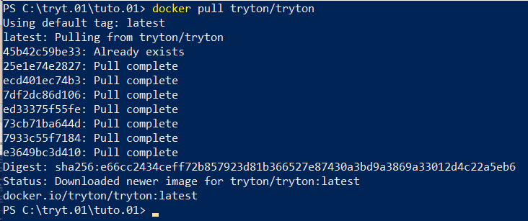
Execute (1/2)
Pull latest Tryton Docker image (note : occurs automatically when not available locally) :
docker pull tryton/tryton

Slide 25
Execute (2/2)
# Obtain latest version of Tryton
docker pull tryton/tryton # Tryton database container + database initialization volatile container docker run --name tryton-postgres -e POSTGRES_PASSWORD=Password -e POSTGRES_DB=tryton -d postgres # Start a PostgreSQL instance
docker run --link tryton-postgres:postgres -e DB_PASSWORD=Password -it tryton/tryton trytond-admin -d tryton --all # Define database tables
# Tryton server containers : tryton & optionally tryton-cron for scheduled actions docker run --name tryton -p 8000:8000 --link tryton-postgres:postgres -e DB_PASSWORD=Password -d tryton/tryton # Start a Tryton instance
docker run --name tryton-cron --link tryton-postgres:postgres -e DB_PASSWORD=Password -d tryton/tryton trytond-cron -d tryton # Start a cron instance
# Obtain Gateway address for usage in pgadmin4 - creating server docker inspect tryton-postgres -f "{{json .NetworkSettings.Networks }}" # "Gateway":"172.18.0.1","IPAddress":"172.18.0.2"
In blue, container and database variable names that can be choosen In red, connection points whose external « p:xyz » can be adapted

Slide 26
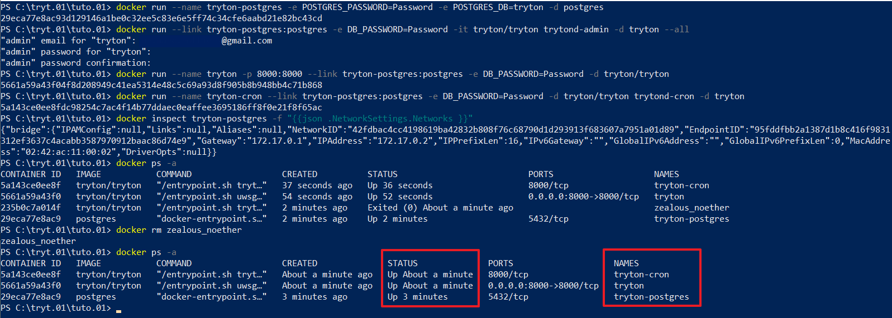
Execute (3/3)
Outcome : the « Gateway":"172.17.0.1" or the "IPAddress":"172.17.0.2" will be used later

Slide 27
Postgres - « Permanent » Data

Slide 28
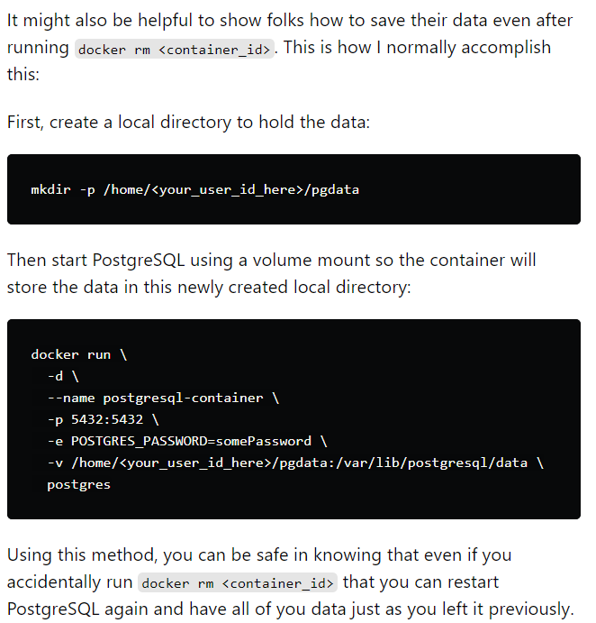
Motivation
The next slides demonstrate how to set up an empty Postgres database. This allows to experiment with using PSQL commands upon a database inside a Docker container.
The script creates a POSTGRES database whose data rests « outside » the container. Even when the container is (accidentally) removed using « docker rm my_postgres_container_name », the database will persist.
See : [https://dev.to/shree_j/how-to-install-and-run-psql-using-docker-41j2]

Slide 29
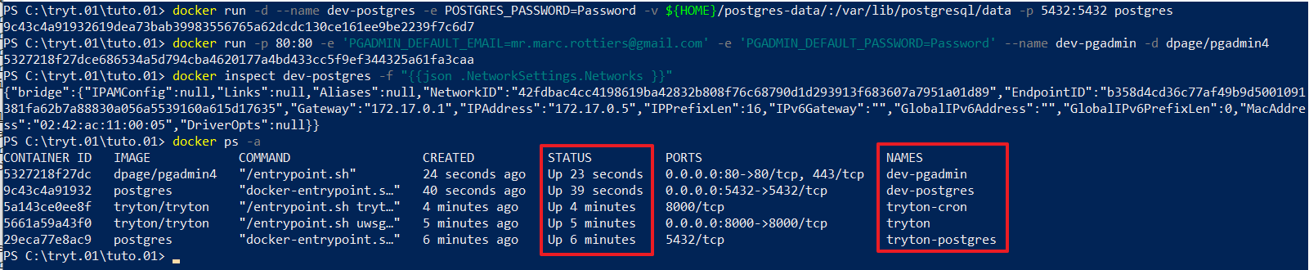
Execute (1/2)
Install :
A container « dev-postgres » from image « postgres » ; « -p 5432: » can be changed
A container « dev-pgadmin » from image « dpage/pgadmin4 » ; « -p 80: » can be changed
# postgres docker pull postgres docker run -d --name dev-postgres -e POSTGRES_PASSWORD=Password -v ${HOME}/postgres-data/:/var/lib/postgresql/data -p 5432:5432 postgres
# pgdamin4 docker pull dpage/pgadmin4 docker run -p 80:80 -e 'PGADMIN_DEFAULT_EMAIL=x@gmail.com' -e 'PGADMIN_DEFAULT_PASSWORD=Password' --name dev-pgadmin -d dpage/pgadmin4
# inspection docker exec dev-postgres ls /var/lib/postgresql/data docker exec -tiu postgres dev-postgres psql -c '\l+'
docker inspect dev-postgres -f "{{json .NetworkSettings.Networks }}"
docker inspect -f "{{range.NetworkSettings.Networks}}{{.IPAddress}}{{end}}" dev-postgres docker inspect -f '{{.Name}} - {{.NetworkSettings.IPAddress }}' $(docker ps -aq)

Slide 30
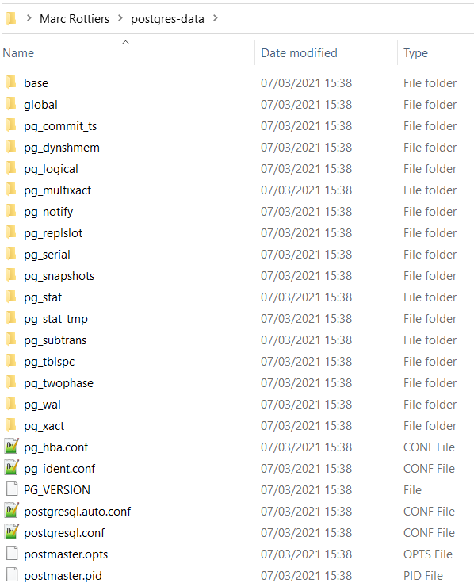
Execute (2/2)
Outcome :
The « postgres-data » directory is created under my user name home directory and not inside a docker container.
Hence the database persists even when the docker container is removed or when the docker application itself is eventually removed.
The « Gateway » "172.17.0.1" or the « IPAddress » "172.17.0.5" (might vary) will be used later in « pgadmin4 » to define the database as part of a server.

Slide 31
Docker Administration

Slide 32
Commands

Slide 33
Commands
Most commands have been explored during the installation process. We repeat them here for convenience
Container commands
docker run hello-world | Check installation still operational
docker ps -a | List containers
docker stop a_container_name | Stop a container
docker start a_container_name | Start a container
docker rm a_container_name | Remove a stopped container
docker logs a_container_name | Logs
docker system prune | Remove stopped containers, unused networks and volumes

Slide 34
Commands
Volume commands
docker volume create a_volume_name | Create a volume
docker volume ls | List the volumes
docker volume rm a_volume_name | Remove a volume
docker volume prune | Remove all unused volumes. « Unused » = container referenced
docker volume inspect a_volume_name | Inspect a volume
Volume commands
docker network create a_network_name | Create a network
docker network ls | List the networks
docker network rm a_network_name | Remove a network
docker network prune | Remove all unused networks. « Unused » = not container referenced
docker network inspect a_network_name | Inspect a network

Slide 35
Reboot

Slide 36
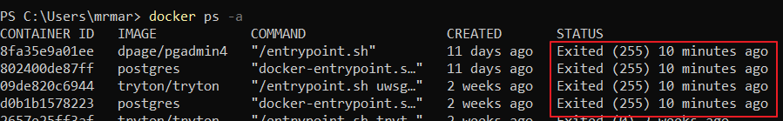
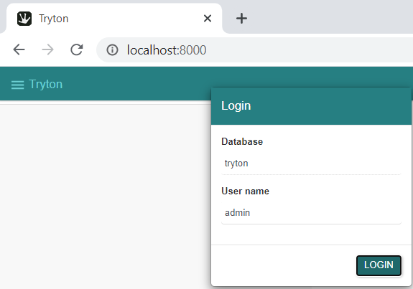
After Reboot
Each time the PC is rebooted, we need to execute the following commands in Powershell
docker ps -a # Control the status
# Start the containers docker start tryton-postgres tryton tryton-cron
docker start dev-postgres dev-pgadmin
Above commands are unnecessary when the PC is set to “Sleep”

Slide 37
Shell Execution

Slide 38
Execute
Executing commands and shells inside a Docker Container is sometimes necessary. Examples are : - Executing « psql » inside the « Postgres » Docker Container
- Executing a Windows command like « ls », « mkdir », « cp between container and windows »
- etc.
Commands
docker exec tryton-postgres ls | List content of directory
docker exec tryton-postgres env | List environment variables
docker cp tryton-postgres:/dump.tar . | Copy tar file from inside of container
docker exec –it tryton-postgres /bin/bash | Executes shell in interactive mode
Usefull documentation : https://martinheinz.dev/blog/3 https://phoenixnap.com/kb/docker-run-command-with-examples

Slide 39

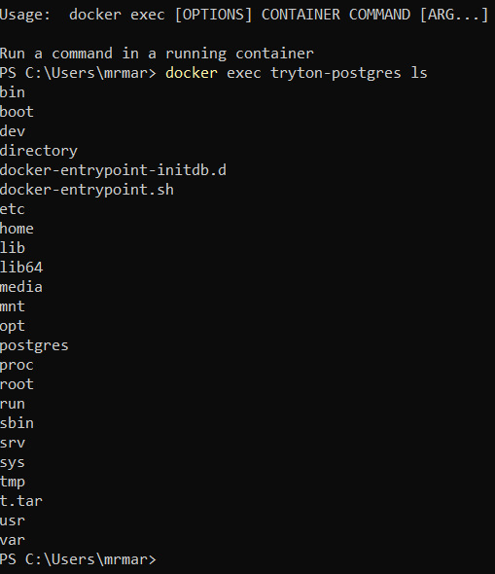
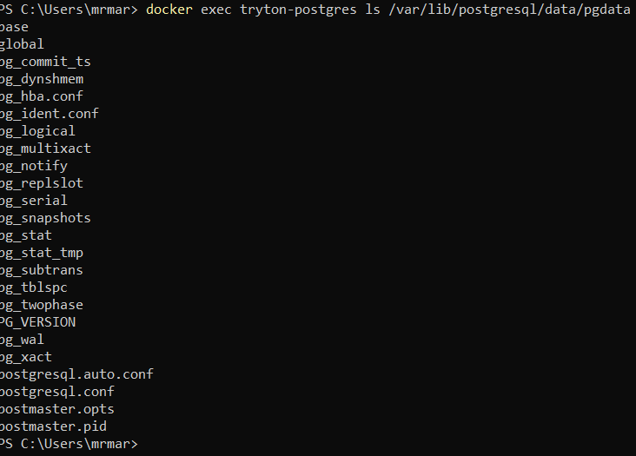
Execute

Slide 40
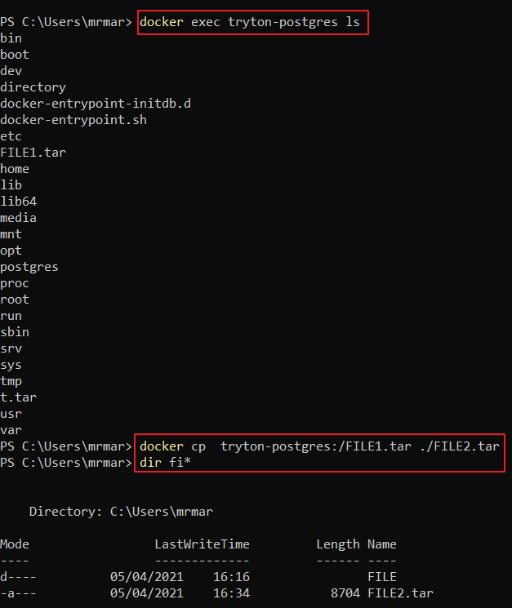
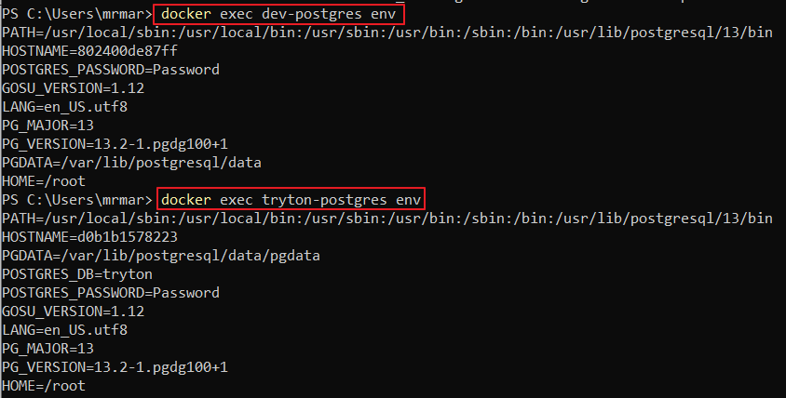
Execute

Slide 41
Container Uninstallation

Slide 42
Deleting everything
docker ps -a
CONTAINER ID IMAGE COMMAND CREATED STATUS PORTS NAMES
132372a60d4b postgres "docker-entrypoint.s…" 2 hours ago Up 2 hours 0.0.0.0:5433->5432/tcp tryton-postgres
4b6f9e99f6b4 tryton/tryton "/entrypoint.sh uwsg…" 2 hours ago Up 2 hours 127.0.0.1:8000->8000/tcp tryton
5a2d77dfdc68 dpage/pgadmin4 "/entrypoint.sh" 5 hours ago Up 2 hours 0.0.0.0:80->80/tcp, 443/tcp dev-pgadmin
f22dca2038de postgres "docker-entrypoint.s…" 5 hours ago Up 2 hours 0.0.0.0:5432->5432/tcp dev-postgres
docker stop tryton-postgres tryton dev-pgadmin dev-postgres
tryton-postgres
tryton
dev-pgadmin
dev-postgres
docker rm tryton-postgres tryton dev-pgadmin dev-postgres
tryton-postgres
tryton
dev-pgadmin
dev-postgres
docker network prune
WARNING! This will remove all custom networks not used by at least one container.
Are you sure you want to continue? [y/N] y
Deleted Networks:
tryton
docker volume prune
WARNING! This will remove all local volumes not used by at least one container.
Are you sure you want to continue? [y/N] y
Deleted Volumes:
0c512afd78d327b43b99e350972e65c25fd4d3ae9be0cfdc362f08298254505f
tryton-database
tryton-data
Total reclaimed space: 55.68MB

Slide 43
Database Backup

Slide 44
Motivation
Explaining how to perform database dump and restore for a database inside a container
Ensuring that these operations preserve UTF8 encoding

Slide 45
Tryton

Slide 46
Tryton - Backup
Note :
The “tryton-postgres” container contains two databases : “postgres” and “tryton”
The “dev-postgres” container (if installed) contains one database : “postgres”
# Generate backup inside of docker container (choose one of three formats)
docker exec tryton-postgres pg_dump -C -c -U postgres -O -f tryton-db-backup.sql tryton docker exec tryton-postgres pg_dump -Fc -U postgres -O -f tryton-db-backup.bak tryton
docker exec tryton-postgres pg_dump -Ft -U postgres -O -f tryton-db-backup.tar tryton # Copy backup to outside of docker container docker exec tryton-postgres ls -l docker cp tryton-postgres:/tryton-db-backup.sql tryton-db-backup.sql docker cp tryton-postgres:/tryton-db-backup.bak tryton-db-backup.bak docker cp tryton-postgres:/tryton-db-backup.tar tryton-db-backup.tar
ls -l
In the examples above :
“tryton-postgres” : name of docker container for tryton database
“tryton” : name of tryton database
Refer to section “Postgres Backup” hereafter for more details

Slide 47
Postgres

Slide 48
Documentation
List of options | http://manpages.ubuntu.com/manpages/trusty/man1/pg_dump.1.html
 | pg_dump --help
How to | http://postgresguide.com/utilities/backup-restore.html
 | https://simkimsia.com/how-to-restore-database-dumps-for-postgres-in-docker-container/
 | https://stackoverflow.com/questions/24718706/backup-restore-a-dockerized-postgresql-database

Slide 49
« pg_dump » - Redirection incorrectly working
Note :
The “tryton-postgres” container contains two databases : “postgres” and “tryton”
The “dev-postgres” container (if installed) contains one database : “postgres”
docker exec tryton-postgres pg_dump -C -c -U postgres -O postgres > postgres-db-backup.sql docker exec tryton-postgres pg_dump -Fc -U postgres -O postgres > postgres-db-backup.bak docker exec tryton-postgres pg_dump -Ft -U postgres -O postgres > postgres-db-backup.tar
Above file content redirections generate incorrect results
File assignment must be used (see hereafter)

Slide 50
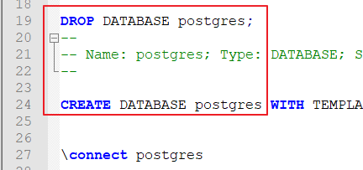
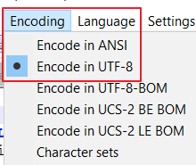

« pg_dump » - Character mode
# Generate backup inside of docker container
docker exec tryton-postgres pg_dump -C -c -U postgres -O -f postgres-db-backup.sql postgres # Copy backup to outside of docker container
docker exec tryton-postgres ls -l docker cp tryton-postgres:/postgres-db-backup.sql postgres-db-backup.sql
ls -l
Generates « drop » and create » « postgres » database commands
Dumps clear text in « correct » UTF8 (the encoding is taken from the database setting)
The file is created inside docker container
If the container is removed, the file is also removed unless it is saved on a persistent volume that is mounted on the container. Alternatively, the file can be copied outside container for preservation.

Slide 51

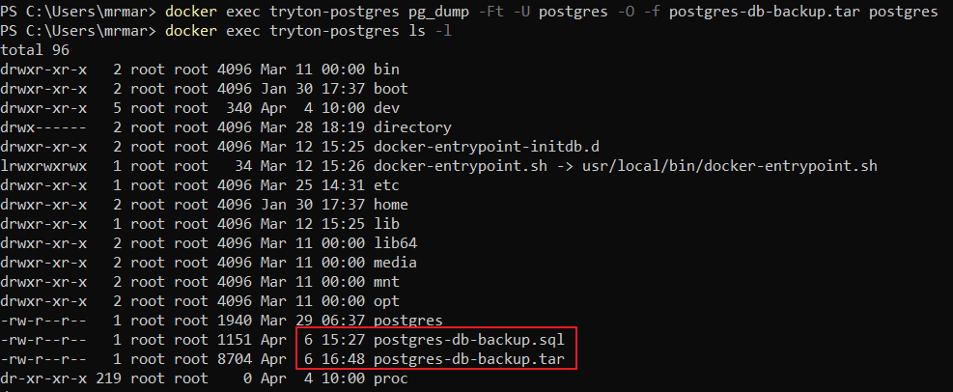
« pg_dump » - Binary Mode
docker exec tryton-postgres pg_dump -Fc -U postgres -O -f postgres-db-backup.bak postgres
docker exec tryton-postgres pg_dump -Ft -U postgres -O -f postgres-db-backup.tar postgres
« Fc » saves in a binary file
« Ft » saves in a « tar » file. It is the most condensed version

Slide 52
Database Restore

Slide 53
Tryton

Slide 54
« pg_restore » - Binary Mode - Example in Context
Use « pg_restore » utility, not « psql »
Before restoring the TRYTON database using the following script, log out the system if you happen to be using it.
See section hereafter about TRYTON Login / Logout
# Step 1.1 : dump tryton
docker exec tryton-postgres pg_dump -Ft -U postgres -O -f tryton-db-backup.tar tryton
# Step 1.2 : export outside container (optional ; specifically use if later import in another container)
docker cp tryton-postgres:/tryton-db-backup.tar tryton-db-backup.tar # Step 2 : docker stop/start containers
docker stop tryton-postgres tryton docker start tryton-postgres tryton
docker ps -a
# Step 3 : drop and create tryton-copy docker exec tryton-postgres dropdb -f -U postgres tryton-copy docker exec tryton-postgres createdb -U postgres -T template0 tryton-copy # Step 4.1 : import inside container (optional ; function of step 1.2 above) docker cp tryton-db-backup.tar tryton-postgres:/tryton-db-backup.tar # Step 4.2 : restore tryton-copy from tryton docker exec -i tryton-postgres pg_restore -Ft -U postgres -d tryton-copy -v ./tryton-db-backup.tar

Slide 55
Errors
We have documented hereafter three error situations we have encountered
We have succeeded in eliminating all of them by tuning the « restore » script
Please report if any error case reappears

Slide 56
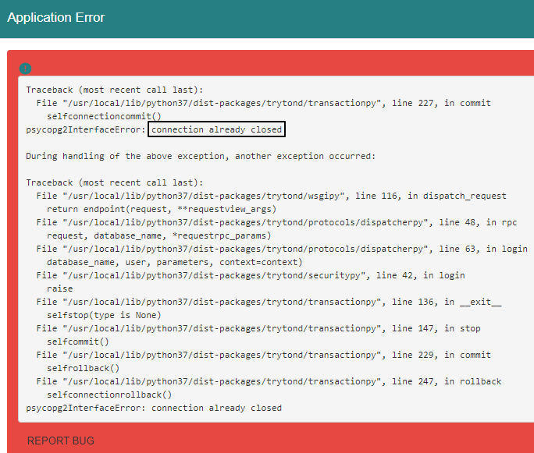
Error #1
It is possible to restore a backup database to its previous state whilst keeping its name unchanged e.g. « tryton »
The restore can occur into the same container (hence overwriting the database) or into a different one
If the error below occurs on login after restore, re-login a second time

Slide 57
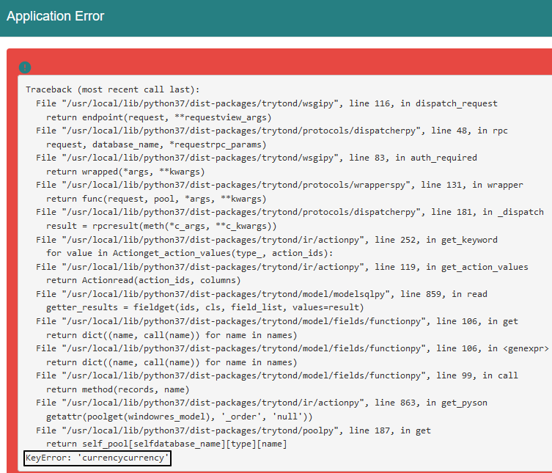
Error #2
It is not possible to restore a backup database whilst changing its name e.g. from « tryt20 » to « tryt21 »
The error occurs whether restoring into the same or a different container as the original one
After login, the error below persists when clicking « Currencies » (e.g.) in the Menu Tree

Slide 58
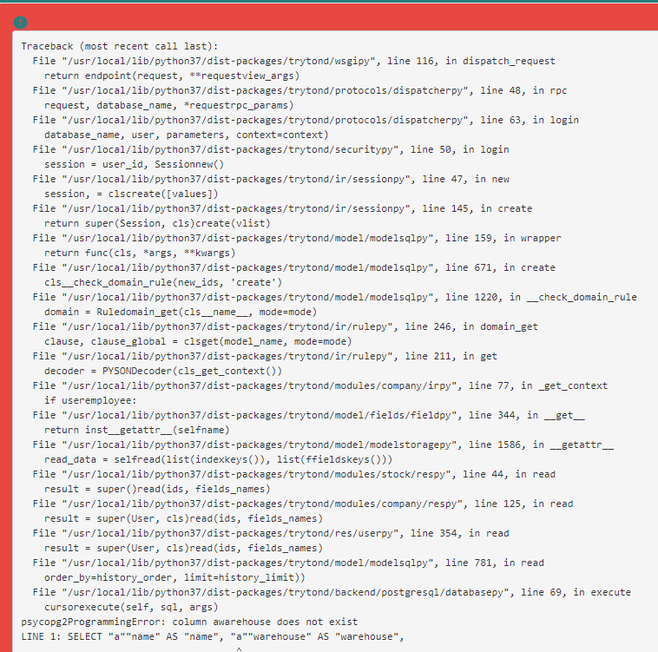
Error #3
We have experienced the following error whilst restoring a database under the same name in its original container
The error disappeared when :
We performed a stop/start operation on the docker TRYTON containers
And subsequently restored the database

Slide 59
Postgres

Slide 60
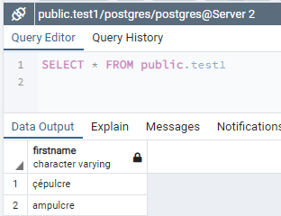
« psql» - Character Mode - Example in Context
Use « psql » utility, not « pg_restore »
Use the file variant « *.sql » when restoring to a different data base name
It does not contain database « drop & create » commands
# Step 1.1 : dump tryton
docker exec tryton-postgres pg_dump -C -c -U postgres -O -f postgres-db-backup.sql postgres
# Step 1.2 : export outside container (optional ; specifically use if later import in another container)
docker cp tryton-postgres:/postgres-db-backup.sql postgres-db-backup.sql # Step 2 : drop and create tryton-copy docker exec tryton-postgres dropdb -f -U postgres postgres-copy docker exec tryton-postgres createdb -U postgres -T template0 postgres-copy # Step 3.2 : import inside container (optional ; function of step 1.2 above) docker cp postgres-db-backup.sql tryton-postgres:/postgres-db-backup.sql # Step 3.2 : restore postgres-copy from postgres docker exec -i tryton-postgres psql -U postgres -f postgres-db-backup.sql postgres-copy

Slide 61
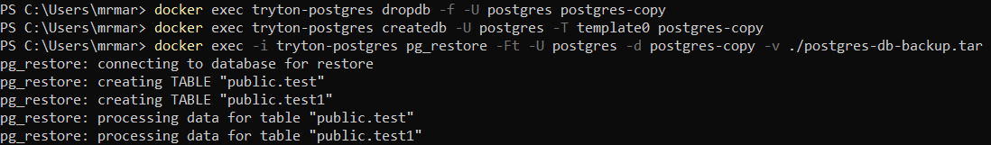
« pg_restore » - Binary Mode - Example in Context
Use « pg_restore » utility, not « psql »
Before restoring the TRYTON database using the following script, log out the system if you happen to be using it.
See section hereafter about TRYTON Login / Logout
# Step 1.1 : dump tryton
docker exec tryton-postgres pg_dump -Ft -U postgres -O -f postgres-db-backup.tar postgres
# Step 1.2 : export outside container (optional ; specifically use if later import in another container)
docker cp tryton-postgres:/postgres-db-backup.tar postgres-db-backup.tar # Step 2 : drop and create tryton-copy docker exec tryton-postgres dropdb -f -U postgres postgres-copy docker exec tryton-postgres createdb -U postgres -T template0 postgres-copy # Step 3.2 : import inside container (optional ; function of step 1.2 above) docker cp postgres-db-backup.tar tryton-postgres:/postgres-db-backup.tar # Step 3.2 : restore postgres-copy from postgres docker exec -i tryton-postgres pg_restore -Ft -U postgres -d postgres-copy -v ./postgres-db-backup.tar

Slide 62
Database Operations

Slide 63
Tryton

Slide 64
List tables of database « tryton »
Exec in Powershell format (exec.ps1) Write-Host "Database Tryton - Schema 'Public' - All Tables - Number of Rows"
Write-Host "init"
docker cp inpu.sql tryton-postgres:/inpu.sql
docker exec -it tryton-postgres psql -d tryton -U postgres -P pager=off -f inpu.sql -o outp.txt docker cp tryton-postgres:/outp.txt outp.txt
Write-Host "fini"
SQL statements (inpu.sql)
-- Data base schema 'public' - All tables - Number of rows
with tbl as (
SELECT table_schema, table_name
FROM information_schema.tables
where table_name not like 'pg_%' and table_schema in ('public')
)
SELECT table_schema, table_name,
(
xpath( '/row/c/text()’, query_to_xml( format('select count(*) as c from %I.%I', table_schema, table_name), false, true, ‘’ ))
)[1]::text::int as rows_nmbr
from tbl
ORDER BY 3 DESC, 2; /* ORDER BY 3 DESC; */ /* ORDER BY 2; */

Slide 65
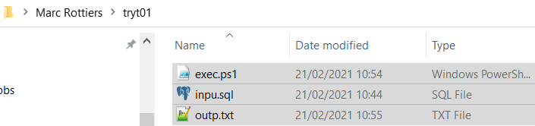
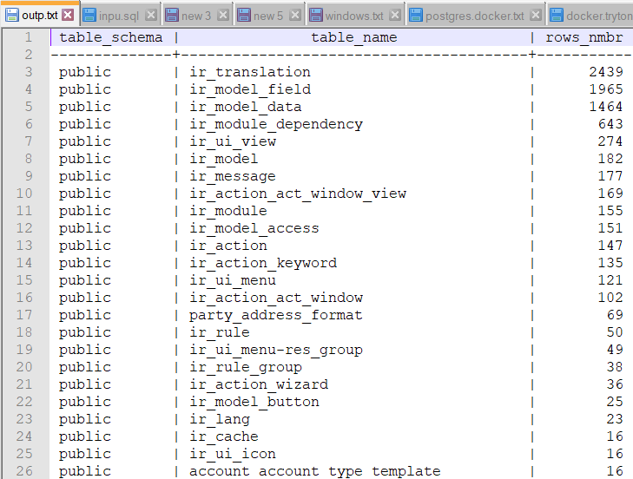
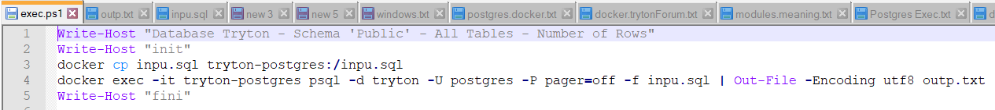
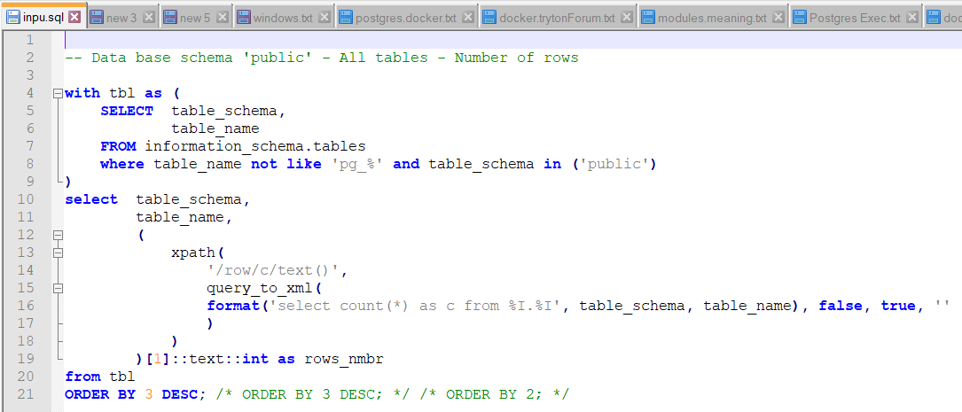
List tables of database « tryton »

Slide 66
Postgres

Slide 67
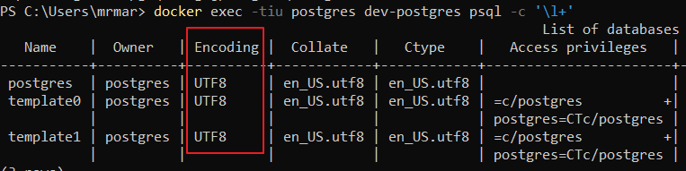
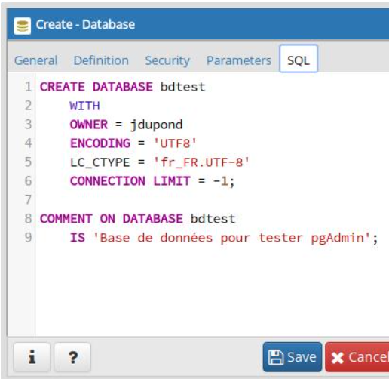
Database creation
CREATE DATABASE test1
WITH
OWNER = postgres
ENCODING = 'UTF8'
LC_COLLATE = 'en_US.UTF-8'
LC_CTYPE = 'en_US.UTF-8'
TABLESPACE = pg_default
CONNECTION LIMIT = -1;

Slide 68
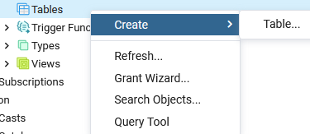
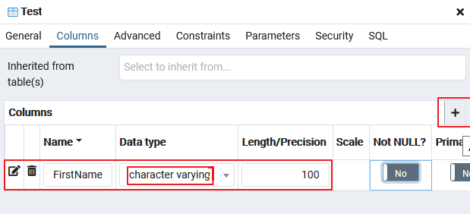
Table creation

Slide 69
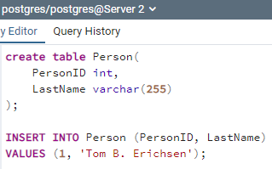
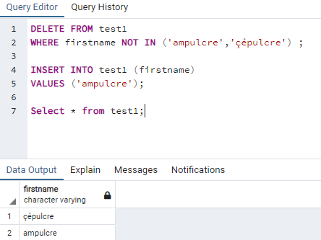
Populate a sample UTF8 table
CREATE TABLE person(
personID int,
firstname varchar(255)
);
INSERT INTO person (personID, firstname)
VALUES (1, 'Tom B. Erichsençé’);
DELETE FROM person
WHERE firstname NOT IN ('ampulcre','çépulcre') ;
INSERT INTO person (personID, firstname)
VALUES (2, 'ampulcrê');
SELECT * from person;

Slide 70
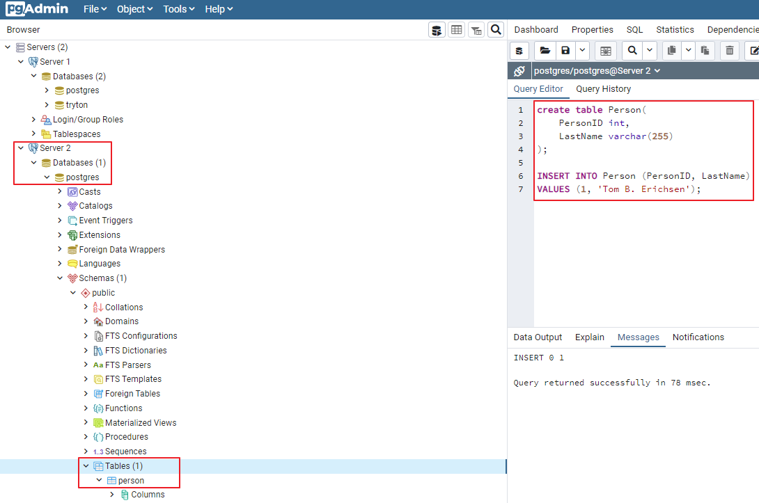
« pgadmin4 » view on Server Databases

Slide 71
User Interface

Slide 72
PgAdmin4

Slide 73
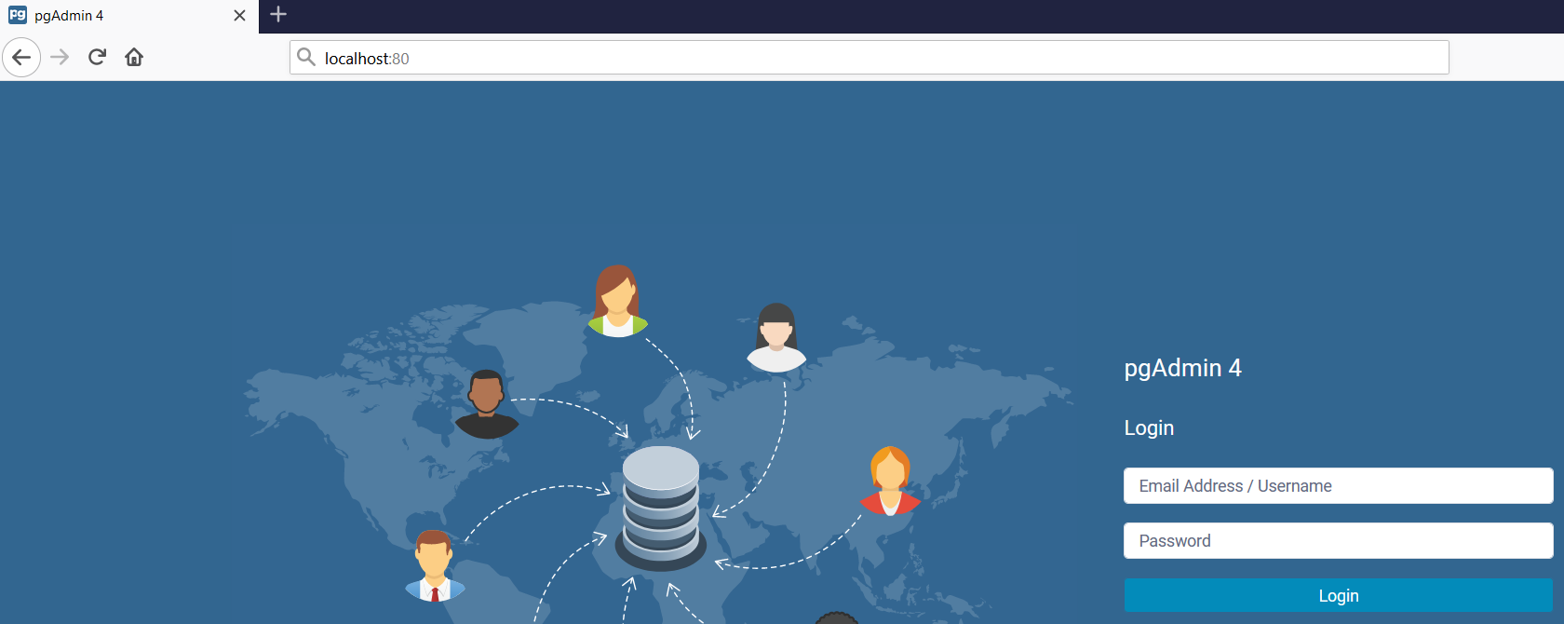
pgAdmin4
Note : We use « Password » as value everywhere a password is required

Slide 74
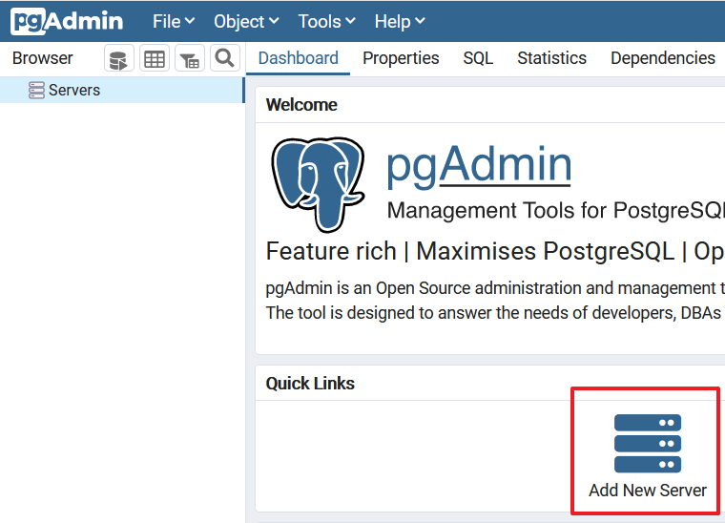
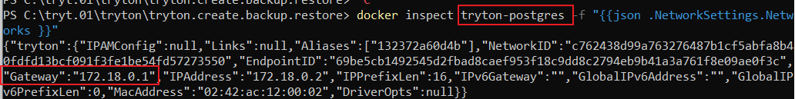
Create servers to connect to the databases

Slide 75
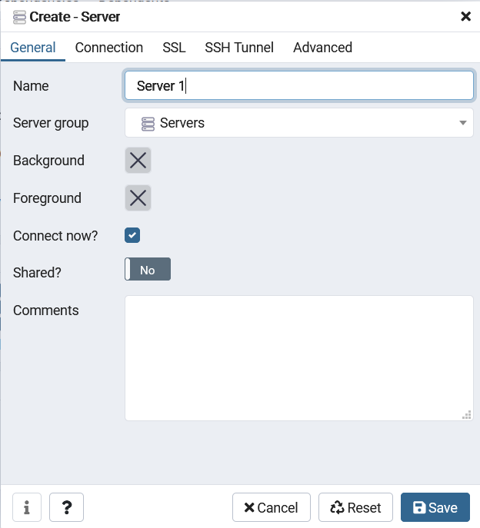
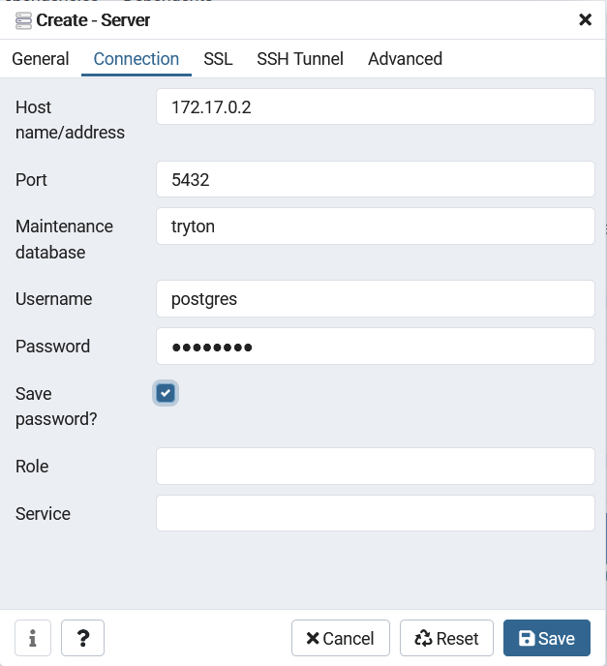
Create servers to connect to the databases

Slide 76
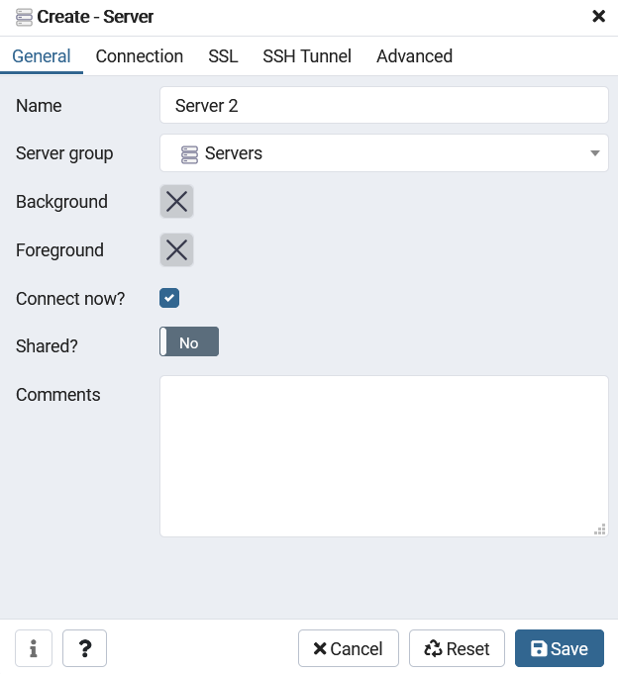
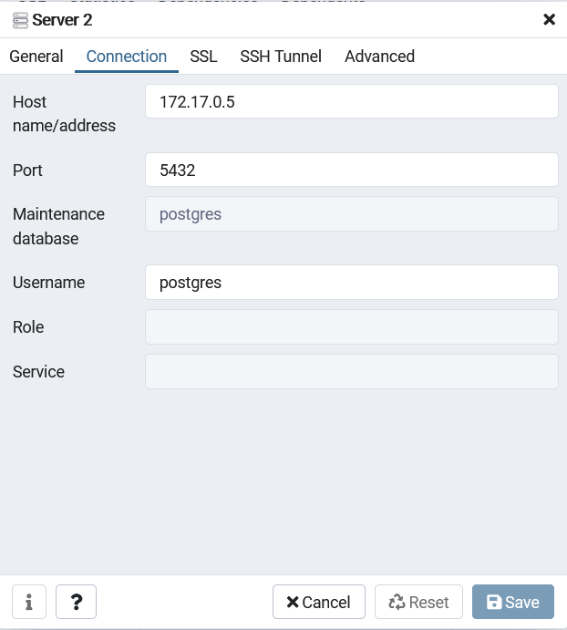
Create servers to connect to the databases

Slide 77
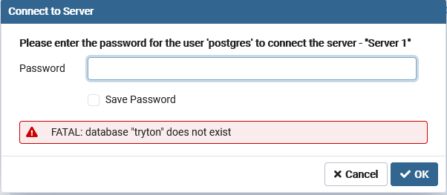
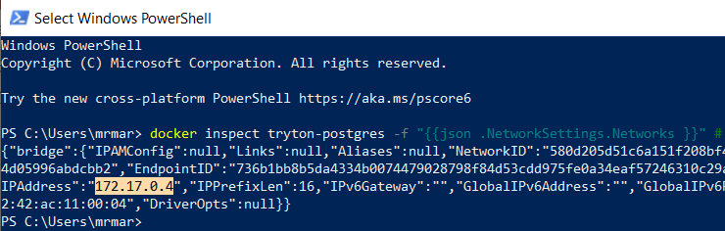
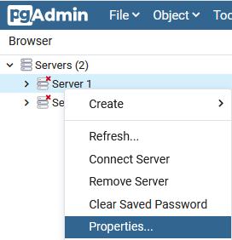
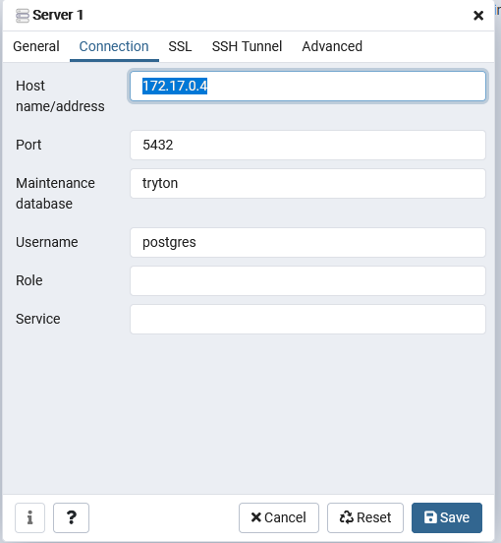
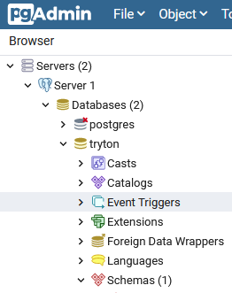
Create servers to connect to the databases - Stability of IP Address
It might be necessary to « adjust » the IP address from time to time in « pgAdmin4 »

Slide 78
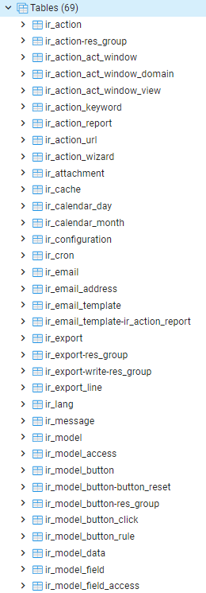
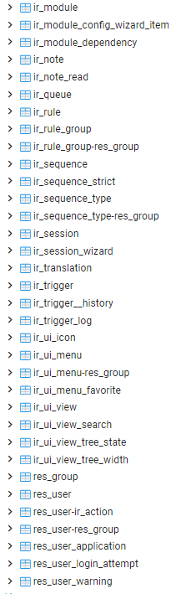

« Tryton » - Database Result
Only « ir » & « res » tables are installed

Slide 79

« Tryton » - Database Result

Slide 80


« Postgres » - Result

Slide 81
Tryton

Slide 82
Login / Logout

Slide 83



Login into Tryton
In this introductory document, all operations are performed with user « admin » and password « Password » at login.

Slide 84
Usage

Slide 85
Using Tryton
The follow-up document « Tryton 5.8 - Doc 05.01 - Basic Entities » explains how to use Tryton

Slide 86
References

Slide 87
Various sources of documentation
Documentation Latest [https://docs.tryton.org/en/latest]
Docker Installation
https://hub.docker.com/r/tryton/tryton/
Classic Installation
[https://blog.lordvan.com/blog/tryton-setup-config/]
[https://www.akarei.cz/tryton/]
Administration Manual
[https://readthedocs.org/projects/tryton-administration-manual/downloads/pdf/latest/]
[https://tryton-administration-manual.readthedocs.io/_/downloads/en/latest/pdf/]
List of Modules [https://discuss.tryton.org/t/list-of-modules-and-what-they-do/2675/7]
Stock
[https://groups.google.com/g/tryton/c/H4ZqsJq37M8/m/W1TaVWu0AQAJ]
[https://docs.tryton.org/en/latest/stock.html#index-stock]

Slide 88
Various sources of documentation
Trytond Documentation [https://readthedocs.org/projects/trytond/downloads/pdf/latest/]
[https://trytond.readthedocs.io/en/latest/]
[https://tryton.readthedocs.io/en/latest/]
[http://hg.tryton.org/readthedocs/]
[https://docs.readthedocs.io/en/latest/subprojects.html]
[https://docs.readthedocs.io/en/latest/alternate_domains.html]

Slide 89
Other sources
Github [https://github.com/tryton]
Downloads
[https://downloads.tryton.org/]

